Slide 1

Sreyas Institute of Engineering and Technology An Autonomous Institution Approved by AICTE, Affiliated to JNTUH Accredited by NAAC-A Grade, NBA (CSE, ECE, ME) & ISO 9001:2015 Certified
PROJECT NAME : PHONE BOOK
BATCH N0 : 12
S.NO STUDENT NAME - H .T.NO
1. Nama Rahul - 22VE1A0439
2. O Manivardhan - 22VE1A0443
3. Posani Divya Tej - 22VE1A0448
4. Rachkonda Yashasvi - 22VE1A0449
5. Sunchu Jyoshna - 22VE1A0458

Slide 2
ABSTRACT :
The PhoneBook is a software application that allows users to store and manage contact information, such as Names, Phone Numbers, email and Addresses.
It can be used to Add,View all, Modify, Search, and Delete contacts in an organized manner.
The program uses arrays, structures, and file handling to store and retrieve data.
The user-friendly interface makes it easy for people of all ages to use and maintain their own personal phonebook.

Slide 3
MODULES :
There are 5 Functions performed in this program :
1. Add Contact
2. List Contacts
3. Edit Contact
4. Search Contact
5. Delete Contact

Slide 4
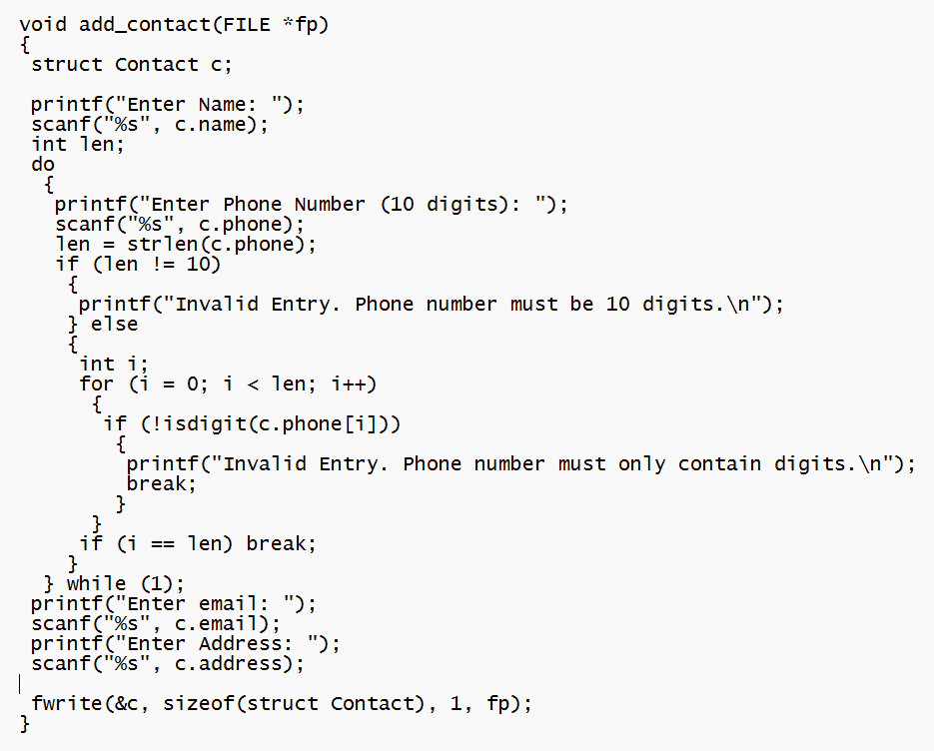
1. Add Contact

Slide 5
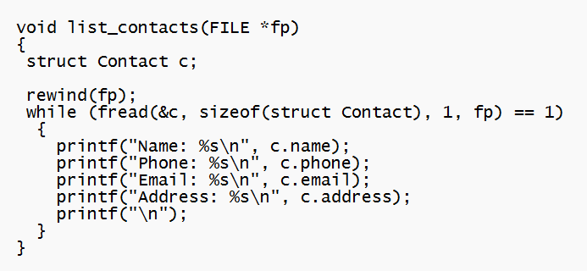
2. List Contacts

Slide 6
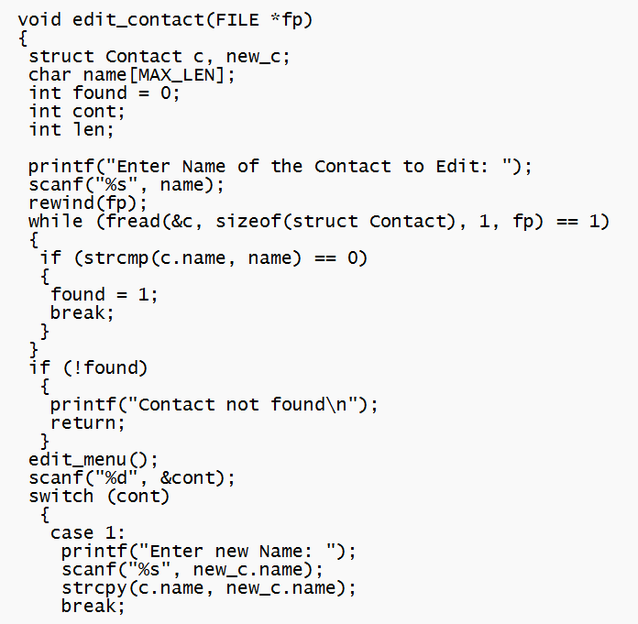
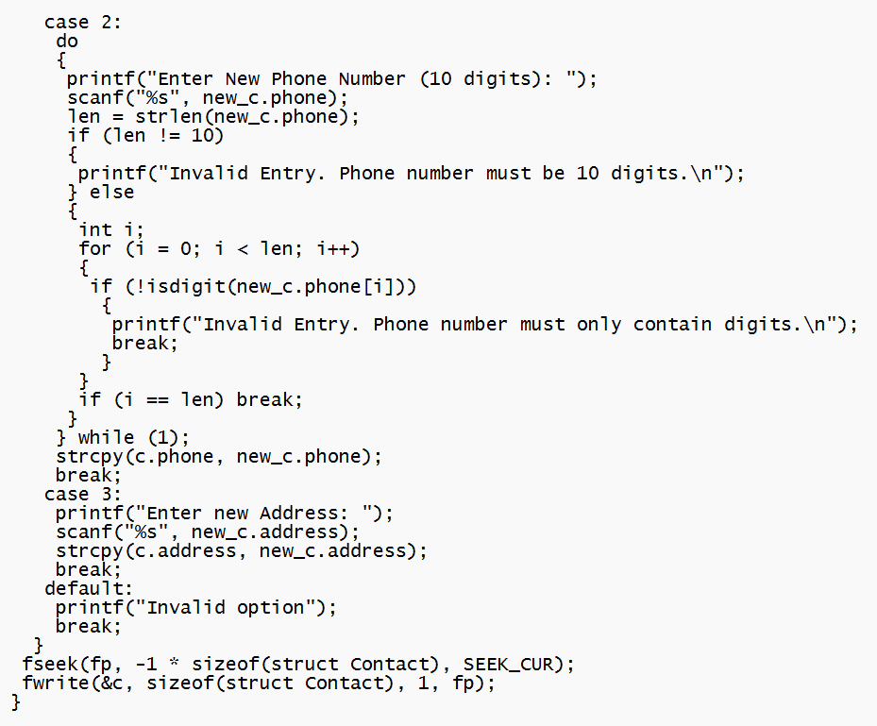
3. Edit Contact

Slide 7
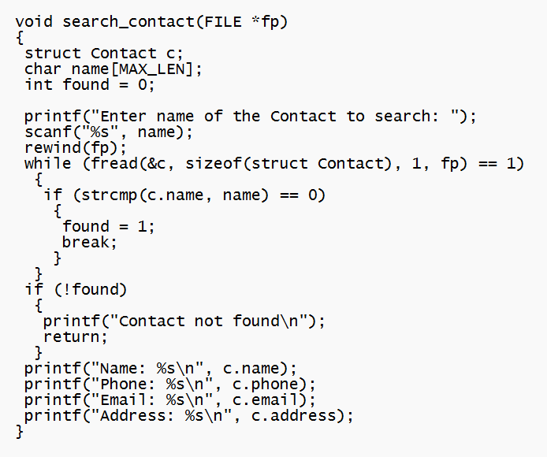
4. Search Contact

Slide 8
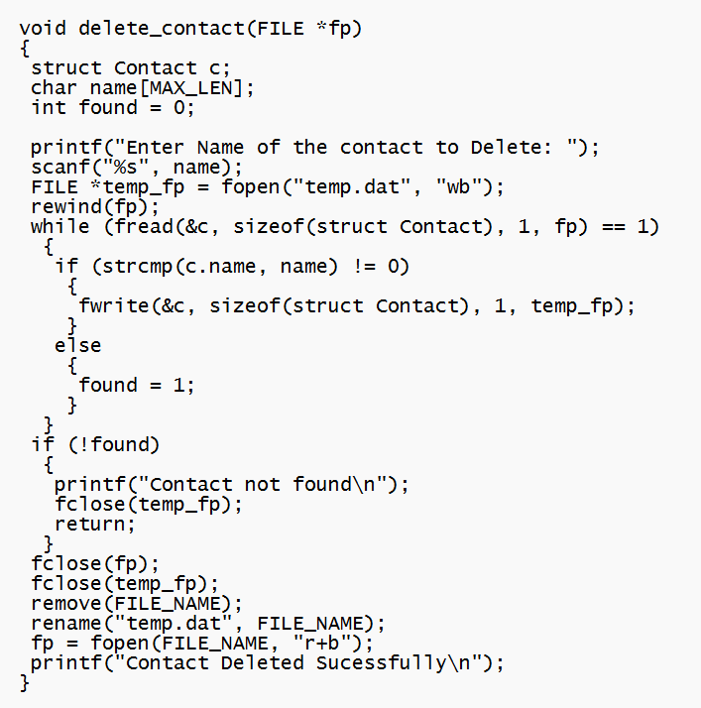
5. Delete Contact

Slide 9
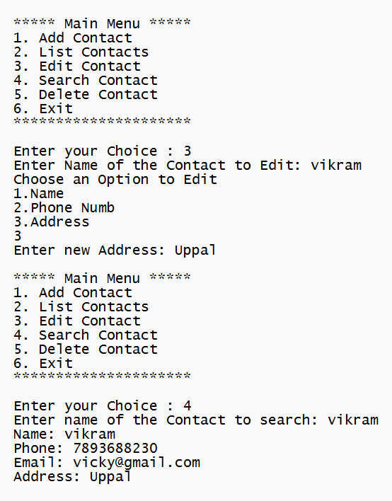
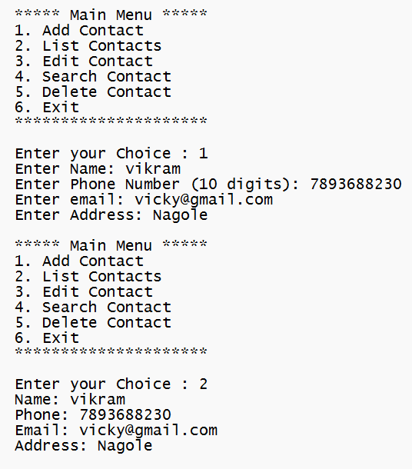
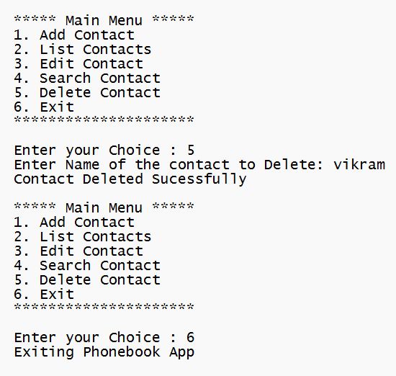
Outputs :

Slide 10
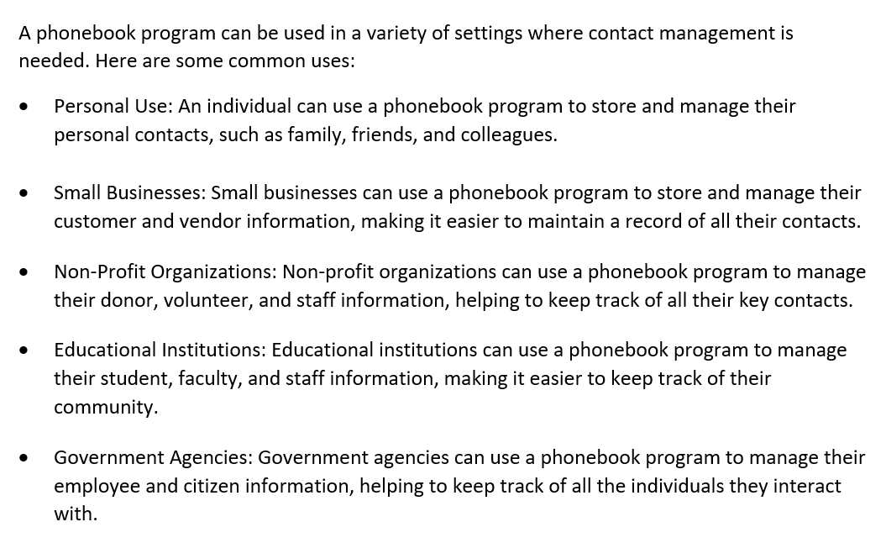
FUTURE WORK :

Slide 11


